Slide 1
Project Final Report
Group 5
By Libang Xia, Yaqi Hu, Luoyuan Zhang, Zhaojin Yin, Gonglin Chen

Slide 2
Project Introduction
Our project mainly focuses on reproducing the result for the paper: Linearizing Transformer with Key-Value Memory with two datasets, in two different NLP tasks - Machine Translation and Text Summarization.
After that, we extended the paper work to a newly published dataset, OpenOrca, and also get the result of MemSizer with it.
Finally, we write a tiny Q & A system as a real world application to see how MemSizer performed in real world scenario.
For all these three tasks, we also compared the result with transformer, with their GPU memory usage, training speed and model size.

Slide 3
Short Review of MemSizer Paper
As the vanilla transformer suffers from quadratic computational overhead, Linearizing Transformer with Key-Value Memory designed to address the computational inefficiencies of transformer.
MemSizer proposes a solution that combines low-rank projections and memory-efficient recurrent-style generation, to solve it.
It introduces a key-value memory layer to replace the multi-head attention layer, simplifying the design by focusing more on the memory values while using fixed-sized, input-independent parametric matrices as memory keys.
This approach retains linear computation time and constant memory complexity, and significantly reduces multi-head computation complexity.

Slide 4
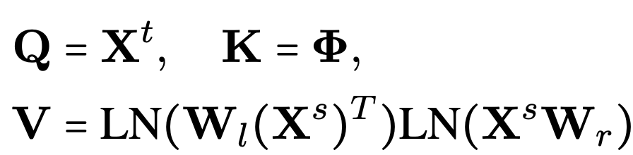
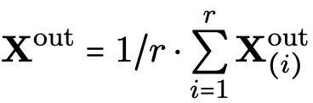
Methodology: MemSizer
NEW Attention
Input dependent K and V.
Dynamic length projections with linear kernel (X^{T}X)
Multi-head Computation (faster):
Notes:
The Key(K) matrix is a learnable parametric matrix, The Value(V) matrix contains k memory value vectors of d dimension. Fixed-size space R(k*d). This unbalanced mechanism emphasizes learning better input dependent values to match with input dependent keys.
Use linear kernel to cancel out the length dimension. Use 2 W matrices to project source information into k global memory value vectors, LN is layer normalization, which makes the training robust. To control magnitude of V, multiply the V by scaling factor of 1/M which replace the h in the original attention mechanism and independent from the input size.
By using new proposed methods, we can just take the average of every attention head.

Slide 5
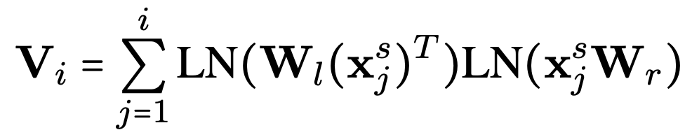
Recurrent Computation (memory efficient):
For each generation step i:
Since x^{s}_{j}is just the jth row of X^{s}, V_{i} can be seen as a rolling-sum matrix
Use cached matrix for computation. (avoid quadratic computation with sequence length)
Notes:
For each time we calculate V, we add a new value into the summation, which can be transformed into a rolling sum of Vi comparing to Vi-1 stored in cached memory

Slide 6
Methodology: Our Tiny Q&A
We trained both vanilla transformers and memsizer with hyper parameters 4 for encoder layers and decoder layers, 512 for model dimension and 2048 feed forward.
We used AdamW optimizer with learning rate of 1*10^(-4) with batch size equal to 64. Both model converges with only one epoch on Google Colab T4 GPU.
We use different vocabulary for Question and Answer. The answer is generated from decoder using greedy decode algorithm. We then deploy these two models with Flask for a web interface which can answer users' question about the value of number place.
Notes:
The Key(K) matrix is a learnable parametric matrix, The Value(V) matrix contains k memory value vectors of d dimension. Fixed-size space R(k*d). This unbalanced mechanism emphasizes learning better input dependent values to match with input dependent keys.
Use linear kernel to cancel out the length dimension. Use 2 W matrices to project source information into k global memory value vectors, LN is layer normalization, which makes the training robust. To control magnitude of V, multiply the V by scaling factor of 1/M which replace the h in the original attention mechanism and independent from the input size.
By using new proposed methods, we can just take the average of every attention head.

Slide 7
Experiments
The two datasets we used for reproducing are: WMT 16 En-De & XSUM
WMT 16 En-De
It contains a collection of English and German parallel texts. The texts are derived from various sources, mainly news websites and other publications.
It typically includes millions of sentence pairs. The dataset is part of the WMT (Workshop on Machine Translation) 2016 challenge, and it’s known for its quality and diversity in terms of sentence structures and vocabulary.
XSUM
It consists of BBC articles and their single-sentence summaries, providing high-quality reference summaries.
It includes tens of thousands of articles and their corresponding summaries, offering a rich resource for training summarization models.
Note: We only using 20000 samples from each dataset!

Slide 8
Experiments
Environment for project tasks: All works are done in the Google Colab, and typically using V100, but some of the work needs A100 to train. (As the memory usage is too large)
We also have a extended datasets, to better see the model performance - OpenOrca
It supports a range of tasks including language mod-
eling, text generation, and text augmentation.
A data instance in this dataset represents entries
from the FLAN collection which have been aug-
mented by submitting the listed question to either
GPT-4 or GPT-3.5. The response is then entered
into the response field. This is the reason why we
choose this dataset.
Code Source: We get the MemSizer code from its officer Github repository. However, the original code cannot be run, so we rewrite the code structure, avoid using missing folders (We don’t know what these folders used), and successfully run it.

Slide 9
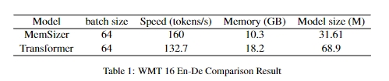
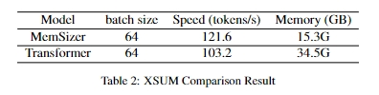
Results & Discussion - Reproduce Result
Note: all the training result are using only 20000 samples from each dataset
Table.1 is for machine translation, we can see that MemSizer used less GPU memory, with a smaller model size, which shows it can reduce the disk usage and achieve a better GPU memory efficiency.
Also, with text summarization task, in Table.2 MemSizer can achieve same performance.

Slide 10
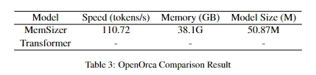
Results & Discussion - Extended Work Result
For the extended work, which shows the similar result like the reproduced result above.
However, as the Colab A100 GPU memory limit is 40G, we cannot run it with transformer on Colab, but we do believe that it could train longer, and has a larger model size.

Slide 11
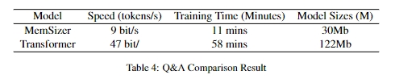
Results & Discussion - Q&A System Result
From the training result shown in Table.4. The vanilla transformer takes about one hour to converge. Surprisingly, when we replace the vanilla transformer with Memsizer, it only take about ten minutes to converge.
From the results, it shows again that the MemSizer is efficient in memory usage and can save training time.

Slide 12
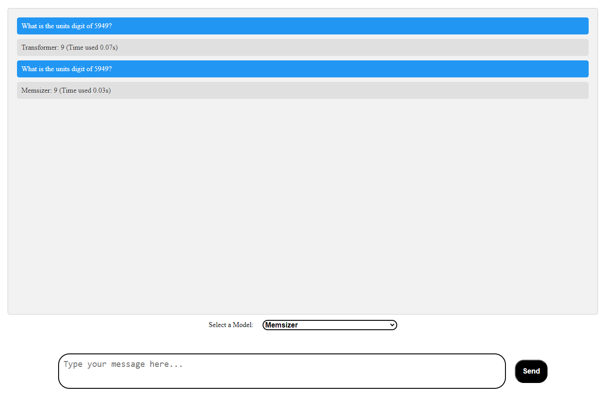
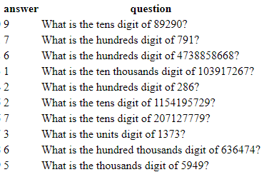
Web UI - Q&A System
We design and implement a Web UI for our Q&A system.
The user can choose between Memsizer and Vanilla Transformer.

Slide 13
Conclusions
To Draw a conclusion for our project, we first reproduced the MemSizer result with two datasets introduced in the paper. (Only using small piece of them).
However, the original code cannot be run, so we rewrite their structure, deleted things that useless, and successfully run it.
Moreover, we extend the MemSizer to a newly published dataset, and compared result with transformer. To better show the improvement, we write a tiny Q&A system as real world application, it also shows the better performance of MemSizer.

Slide 14
Conclusions
From the result we get in two part of our project, we can see that MemSizer do have a great GPU memory usage efficiency and can achieve shorter training time, with smaller model size.
It show potential helpings to LLM, as they suffer from long training time, and large model size, also shows in the OpenOrca result. It highlighting the potential of MemSizer in optimizing transformer-based system.
The result also offers valuable insights into the adaptability of MemSizer across different tasks with old structure, and it's implications for future application in similar AI-driven systems.

Slide 15
THANK YOU!!!
Q&A

